Slide 1
UNIT-3
Distributed Operating Systems
OPERATING SYSTEM CONCEPTS
UNIT-3
Distributed Operating Systems

Slide 2
Distributed Operating Systems
A distributed operating system is system software over a collection of independent, networked, communicating, and physically separate computational nodes.
They handle jobs which are serviced by multiple CPUs. Each individual node holds a specific software subset of the global aggregate operating system.
Distributed Operating System is a model where distributed applications are running on multiple computers linked by communications.
A distributed operating system is an extension of the network operating system that supports higher levels of communication and integration of the machines on the network.
This system looks to its users like an ordinary centralized operating system but runs on multiple, independent central processing units (CPUs).

Slide 3
Distributed Operating Systems
These systems are referred as loosely coupled systems where each processor has its own local memory and processors communicate with one another through various communication lines, such as high speed buses or telephone lines.
By loosely coupled systems, we mean that such computers possess no hardware connections at the CPU – memory bus level, but are connected by external interfaces that run under the control of software.
The Distributed Os involves a collection of autonomous computer systems, capable of communicating and cooperating with each other through a LAN / WAN.
A Distributed Os provides a virtual machine abstraction to its users and wide sharing of resources like as computational capacity, I/O and files etc.

Slide 4
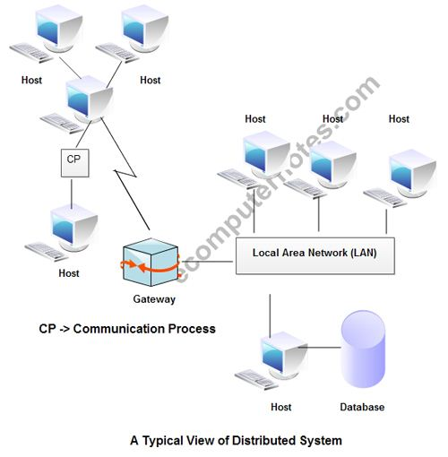
Distributed Operating Systems

Slide 5
Distributed Operating Systems
The structure shown in fig contains a set of individual computer systems and workstations connected via communication systems, but by this structure we can not say it is a distributed system because it is the software, not the hardware, that determines whether a system is distributed or not.
The users of a true distributed system should not know, on which machine their programs are running and where their files are stored.
LOCUS and MICROS are the best examples of distributed operating systems.
Using LOCUS operating system it was possible to access local and distant files in uniform manner.
This feature enabled a user to log on any node of the network and to utilize the resources in a network without the reference of his/her location.
MICROS provided sharing of resources in an automatic manner. The jobs were assigned to different nodes of the whole system to balance the load on different nodes.

Slide 6
Distributed processing means where data &/or process is distributed on different machines.
In distributed processing a number of computers have to be connected to one another by links along with the distribution of data among various computers.
A distributed system is a system that do not only share memory or a clock but distribute resources.
Work is distributed to different machines
CPU 1
LAN
CPU2
CPU3
CPU 4
CPU
LAN
Main Server
Main advantages of distributed OS are :
Resource Sharing
Computation Speed
Reliability
Communication ability
Types of Distributed System are
  Client Server System
  Peer to peer systems
  c) Network OS
  d) Global OS

Slide 7
Advantages of Distributed OS
Resource Sharing
This feature of distributed OS provides mechanisms for sharing files at remote sites, processing information in a distributed database, printing files at remote sites. For this it uses remote specialized hardware devices.
Machine 1
Machine 2
Network
Machine 3
Computation speed
With the help of load sharing & concurrent execution of distributed work the overall computation speed is increased.
3. The reliability of distributed OS is very high as even if one site fails in distributed environment but still the remaining other site can continue to work.
4. All the works in such OS can be carried out simultaneously on separate remote places.
5. Different computers communicate to each other through the message passing system.

Slide 8
 | Distributed |  | Centralized
1 | Here a number of computers are connected together to form a network. | 1 | Here a number of computers are connected to a server to form a network.
2 | Work is distributed evenly on all the computers under network. | 2 | The complete data & work is stored on central server from where the terminals accesses the data for processing.
3 | It contains distributed controlling systems. | 3 | Centralized controlling system
4 | It includes distributed applications, distributed data & distributed controls. | 4 | It contains centralized computer system with centralized applications, centralized data & centralized controls.
5 | Example is : NT | 5 | Example is : Unix
6 |  | 6
m1
m1
m1
m2
m5
Central server
m4
m3
m1
m1

Slide 9
Examples of Distributed OS
LOCUS
In LOCUS operating system, can be accessed local and remote file in simultaneously without any location hindrance.
MICROS
MICROS operating system maintains the balance load of data while allotting the jobs to all nodes of entire system.
IRIX
IRIX operating system is used in the UNIX system V and LINUX.
DYNIX
DYNIX operating system is developed for the Symmetry multiprocessor computers.
AIX
AIX operating system is designed for IBM RS/6000 computers.
Solaris
Solaris operating system designed for SUN multiprocessor workstations.

Slide 10
Examples of Distributed OS
Other Important Examples of Distributed Operating System
Windows server 2003
Windows server 2008
Windows server 2012
Ubuntu
Linux (Apache Server)

Slide 11
Applications of Distributed OS
There are various real life applications of operating system such as
Telecommunication networks
Internet Technology
Airline reservation Control systems
Distributed databases System
Air Traffic Control System
Automated Banking System
Multiplayer online gaming
Cluster Computing
Grid Computing
Routing Algorithms
Network File System

Slide 12
Thank You
Have a Good Day!

